Slide 1
Homework 3
COSE331 Computer Graphics

Slide 2
Goal
Implement forward kinematics
Apply skinning on the mesh
Interpolate the animation between key frames

Slide 3
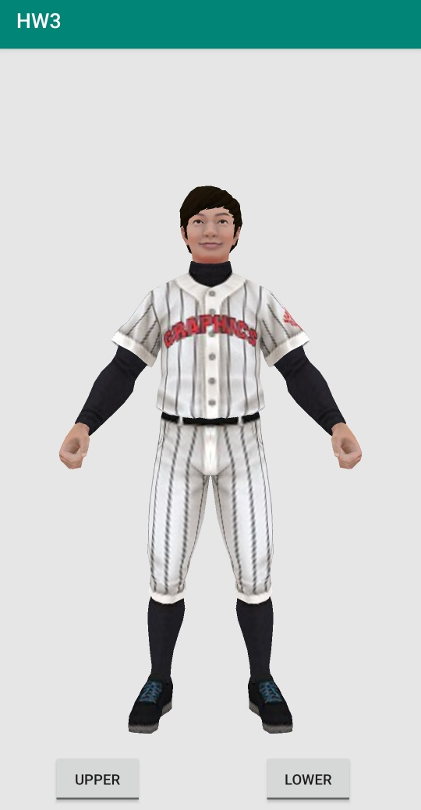
Initial state
Character is in T-pose.

Slide 4
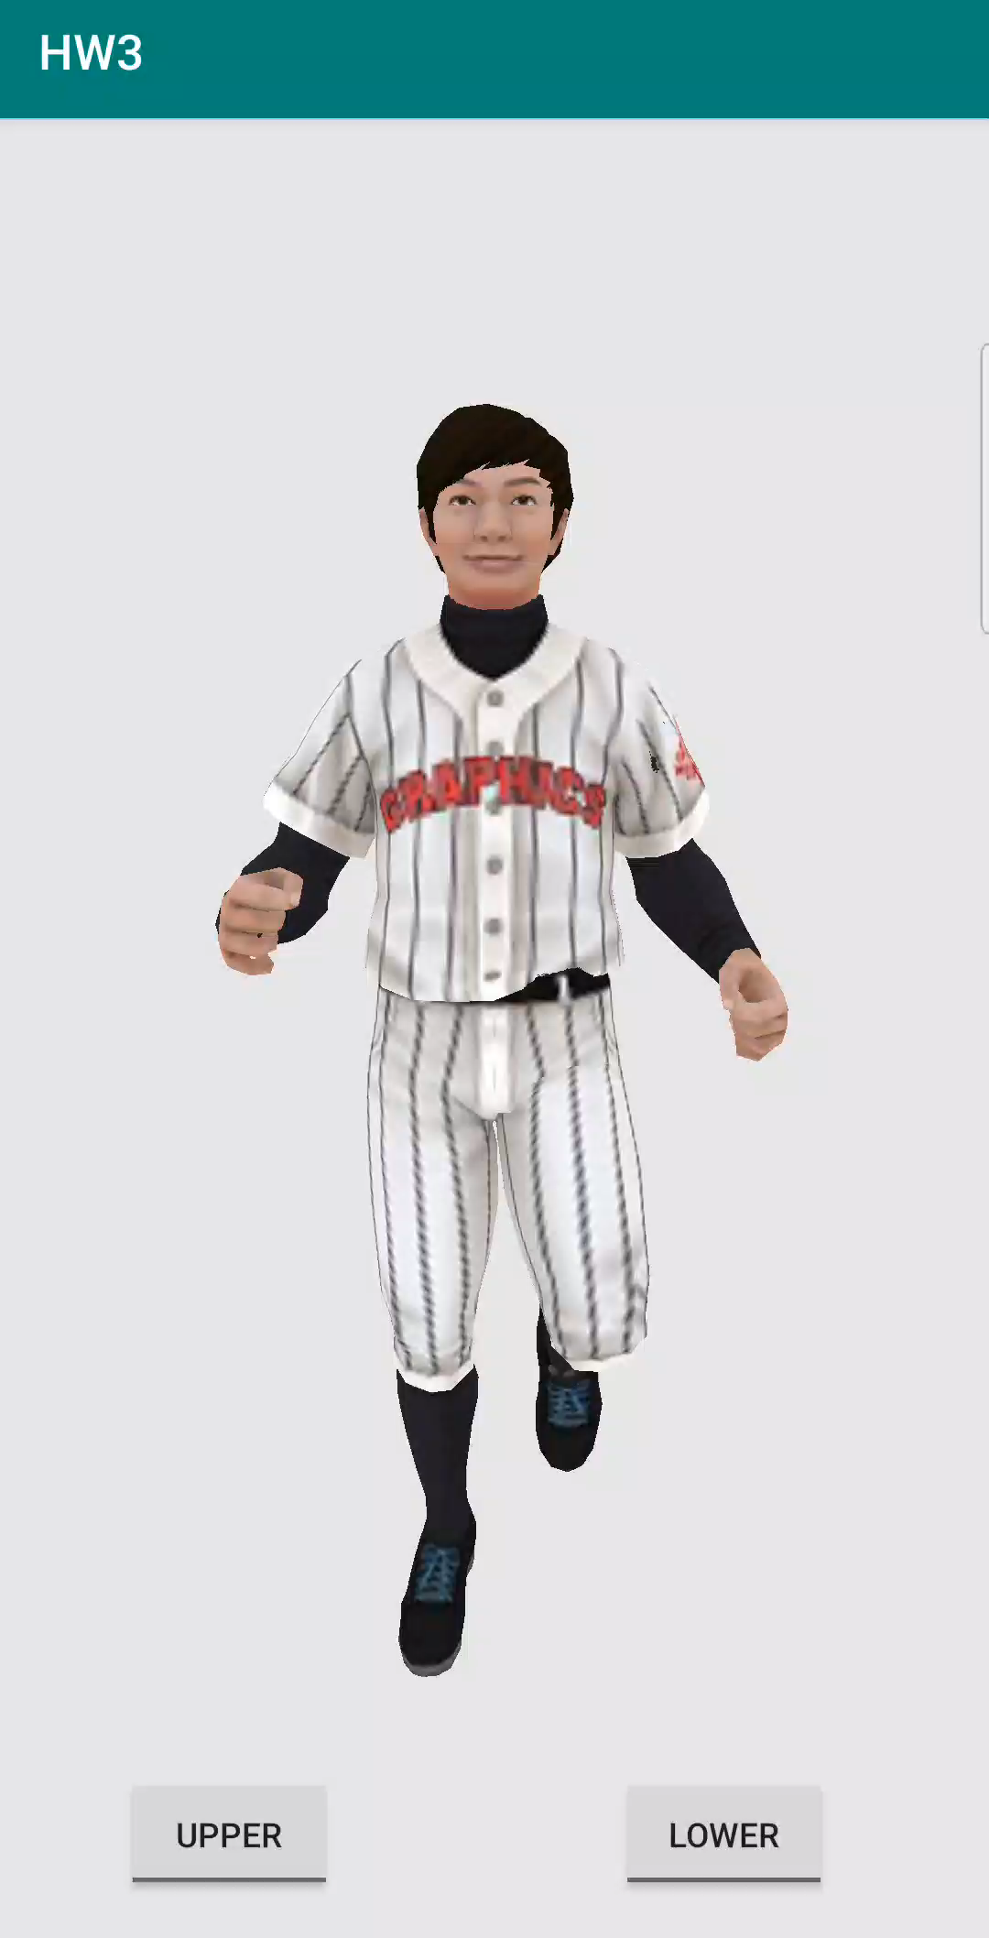
Final Result
Character runs through the screen.
Add some functions with the toggle buttons
Upper button
stop/move the animation of the upper body
Lower button
stop/move the animation of the lower body

Slide 5
Skeleton data
The skeleton data will be provided in inc/binary/skeleton.h header file.
It has 28 joints including the root.
jNames[i] : the name of i-th joint
jParents[i] : the index of the parent of i-th joint
jOffset[i] : the offset between i-th joint and its parent joint

Slide 6
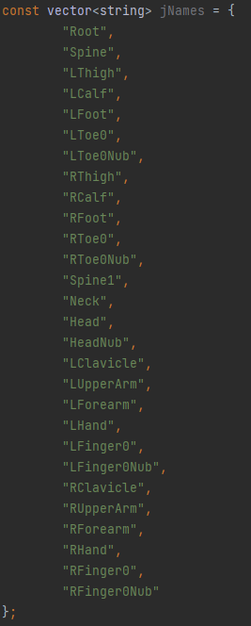
Skeleton data
Assume that the joints in the red box as the lower body
Assume that the joints in the blue box as the upper body

Slide 7
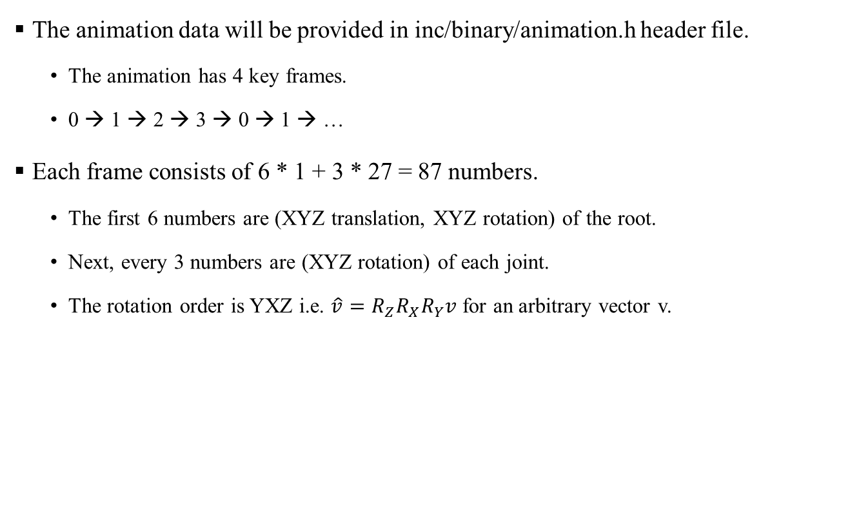
Animation data
The animation data will be provided in inc/binary/animation.h header file.
The animation has 4 key frames.
0 → 1 → 2 → 3 → 0 → 1 → …
Each frame consists of 6 * 1 + 3 * 27 = 87 numbers.
The first 6 numbers are (XYZ translation, XYZ rotation) of the root.
Next, every 3 numbers are (XYZ rotation) of each joint.
The rotation order is YXZ i.e. $\hat{v}=R_{Z}R_{X}R_{Y}v$ for an arbitrary vector v.

Slide 8
Mesh data
The mesh data will be provided in inc/binary/player.h header file.
playerTexels: the square texture
playerSize: the resolution of playerTexels
playerVertices: the mesh
playerIndices: the index of the mesh
Vertex structure is slightly modified for skinning.
Vertex.bone: the index of skinned skeleton
Vertex.weight: the weight of skinning

Slide 9
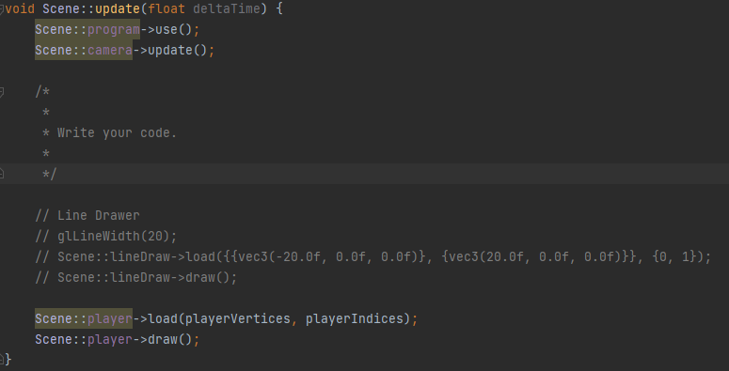
Problem
Write the code in Scene::update(float deltaTime) function.
Calculate the elapsed time from the start by accumulating deltaTime.
Repeat the animation every 4 seconds.
Convert the animation from Euler angles to quaternions.
Interpolate the animation.
Update VBO and IBO of the object.
Apply the skinning with the weight blending.

Slide 10

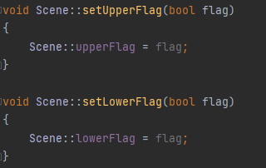
Problem
The flag variables are automatically set when the toggle button is pressed/released.
When the toggle button is pressed, the flag is set to false and stop the animation.
When the toggle button is released, the flag is set to true and move the animation.
Ex) When the upper button is pressed, stop the animation of the upper body.
upperFlag is set to false

Slide 11

Tip
You can use the OpenGL Mathematics (GLM) functions.
GLM is a C++ header only library for graphics software based on the GLSL specifications.
GLM functions are included in “app/src/main/cpp/inc/glm”.
Useful glm function
glm::rotate
glm::translate
glm::quat_cast
glm::mat4_cast
glm::mix
glm::slerp
Documentations can be found here. [link]

Slide 12
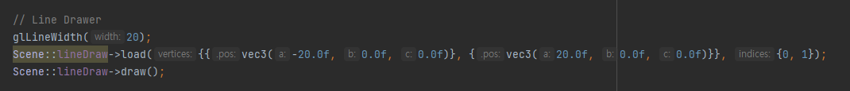
Tip
Visualize the skeleton.
The object with the line drawer will be provided.
Fill the VBO and IBO to visualize the skeleton.

Slide 13
Tip
Overlap the skeleton and the mesh.
If the skeleton and the mesh view the different direction, the result will be weird.
Apply the skinning without the weight blending.
The result is good enough.
The mesh and the skeleton are too big.
Note that the mesh is scaled down to 1/3.

Slide 14
Submission
Deadline
June 7 (Wed) 14:00
Submission files ({student_id}_{name}.zip)
Scene class file (app/src/main/cpp/scene.cpp)
Submission to Blackboard
Contact
TA email: 2023.cg.ta@gmail.com

